Slide 1

Micro Credit Defaulter Project
Presented By: Safiya Firdose Khan

Slide 2
Agenda:
Introduction
Problem Statement
Objective
Exploratory Data Analysis (EDA)
Visualization
Inference
Future Work

Slide 3
Acknowledgement:
I would like to express my sincere thanks of gratitude to my mentors from Data Trained academy and Flip Robo Technologies,
Bangalore for letting me work on this project. Their suggestions and directions have helped me in the completion of this project successfully. All the required information & the dataset are provided by Flip Robo Technologies.
Finally, I would like to thank my family and friends who have helped me with their valuable suggestions and guidance and have been very helpful in various stages of project completion.

Slide 4
Overview:
In this particular presentation we will be looking on:
How to analyze the dataset of Micro Credit Defaulter Project Classifier.
What are the EDA steps in cleaning the dataset.
Overall analysis on the problem.
Model building from the cleaned dataset.
Predictions for test dataset from saved model.

Slide 5
Introduction: Business Problem Framing:
A Microfinance Institution (MFI) is an organization that offers financial services to low-income populations. MFS becomes very useful when targeting especially the unbanked poor families living in remote areas with not much sources of income.
They understand the importance of communication and how it effects a person’s life and lack of communication can cause lot of uncertain problems, thus, focusing on providing their services and products to low-income families and poor customers that can help them in the need of hour.

Slide 6
Conceptual Background of the Domain Problem:
MFS are collaborating with an MFI to provide micro-credit on mobile balances to be paid back in 5 days. The Consumer is believed to be defaulter if he deviates from the path of paying back the loaned amount within the time duration of 5 days. For the loan amount of 5 (in Indonesian Rupiah), payback amount should be 6 (in Indonesian Rupiah), while, for the loan amount of 10 (in Indonesian Rupiah), the payback amount should be 12 (in Indonesian Rupiah).

Slide 7
Review of Literature:
The Microfinance services (MFS) provided by MFI are Group Loans, Agricultural Loans, Individual Business Loans and so on. Many microfinance institutions (MFI), experts and donors are supporting the idea of using mobile financial services (MFS) which they feel are more convenient and efficient, and cost saving, than the traditional high-touch model used since long for the purpose of delivering microfinance services. Though, the MFI industry is primarily focusing on low-income families and are very useful in such areas, the implementation of MFS has been uneven with both significant challenges and successes. 4 | P a g e MICROCREDIT DEFAULTER PROJECT Today, microfinance is widely accepted as a poverty-reduction tool, representing $70 billion in outstanding loans and a global outreach of 200 million clients.

Slide 8
Motivation for the Problem Undertaken:
We understand the importance of communication and how it effects a person’s life and lack of communication can cause lot of uncertain problems so we want to work in order to bridge this gap between people. We are working with one such client that is in Telecom Industry. They are a fixed wireless telecommunications network provider. They have launched various products and have developed its business and organization based on the budget operator model, offering better products at Lower Prices to all value conscious customers through a strategy of disruptive innovation that focuses on the subscriber.

Slide 9
Exploratory Data Analysis (EDA) :
Importing necessary libraries and importing dataset as a data frame.
Checked some statistical information like shape, number of unique values present, info, finding zero values etc.
Dropped some columns containing more than 90% of zero values assuming they won’t create skewness in later part.
Dataset was free from null values that is I found no missing values.
Extracted Day, Month and Year features from pdate column.
Found some negative/invalid values while checking the statistical summary of the dataset so, converted them into positive by using absolute command.
Visualizing the features using univariate and bivariate analysis. Univariate analysis is the simplest form of analysing the data. “Uni” means “one”, visualizing the data using one variable. Bivariate analysis is another form of analysing the data. “Bi” means “two”, visualizing the data using 2 variables.

Slide 10
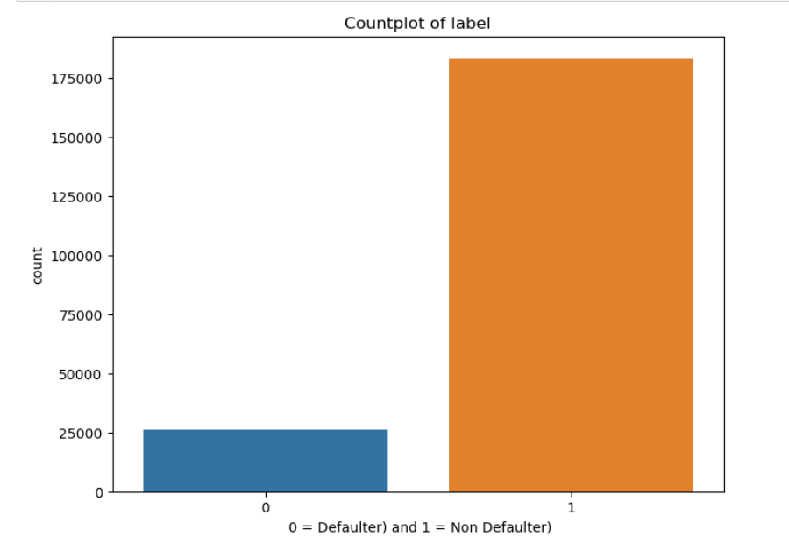
Visualizations: Univariate analysis:
Count plot of label:
As we can see, majority of the customers are non-defaulters.

Slide 11
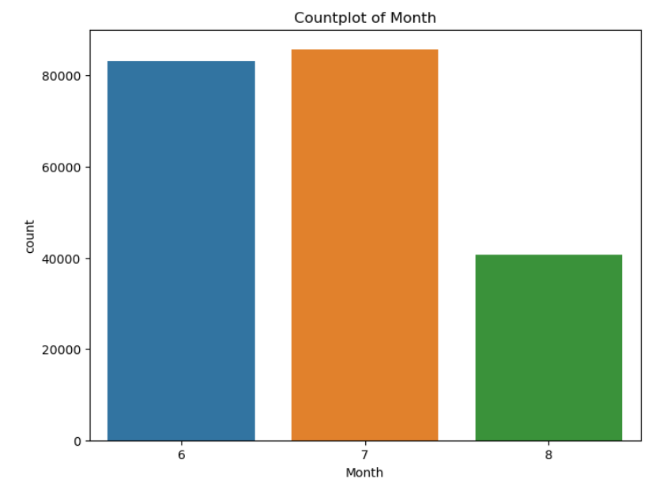
Count plot of Month:
As we can see, majority of the customers (85765) have taken credit in the 7th month.

Slide 12
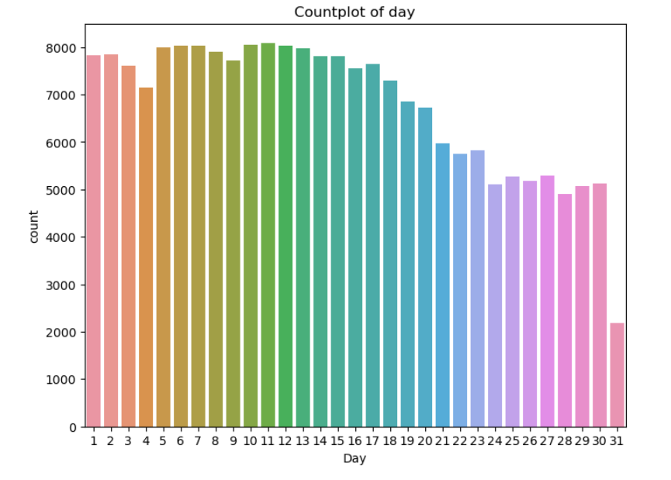
Count plot of day:
As we can see, majority of the customers (8092) have taken credit on the 11th day of the month.

Slide 13
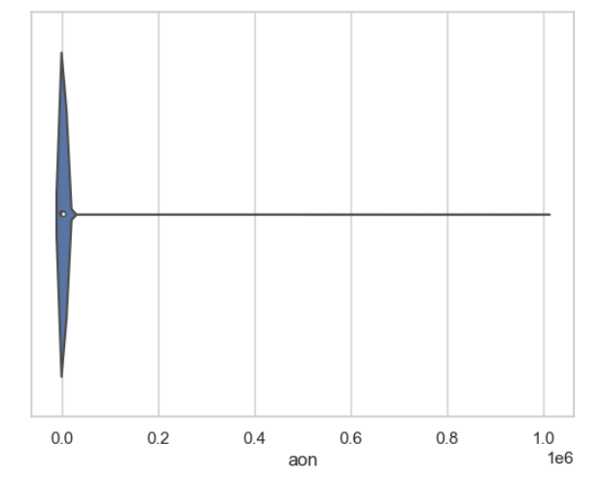
Violin plot of aon:
As we can see, age on cellular network in days of maximum customers is 95 days.

Slide 14
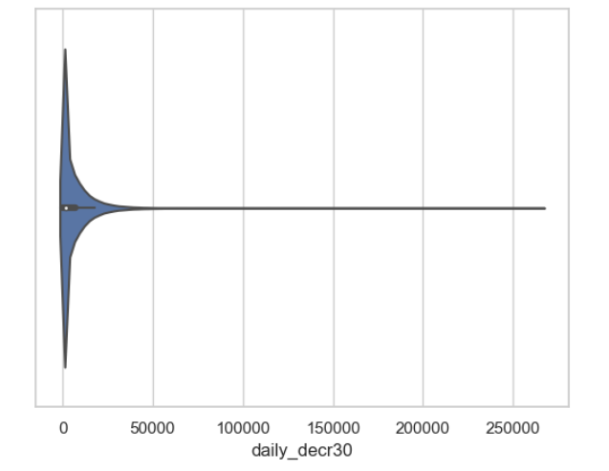
Violin plot of daily_decr30:
As we can see, daily amount spent from main account, averaged over last 30 days for majority of the customers is 0.

Slide 15
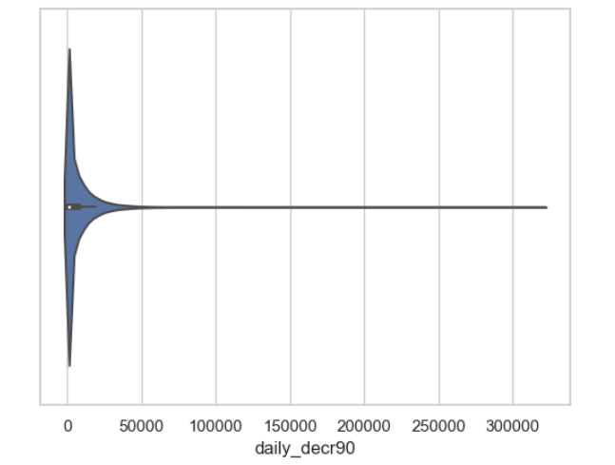
Violin plot of daily_decr90:
As we can see, daily amount spent from main account, averaged over last 90 days for majority of the customers is 0.

Slide 16

Violin plot of rental30:
As we can see, average main account balance over last 30 days for majority of the customers is 0.

Slide 17
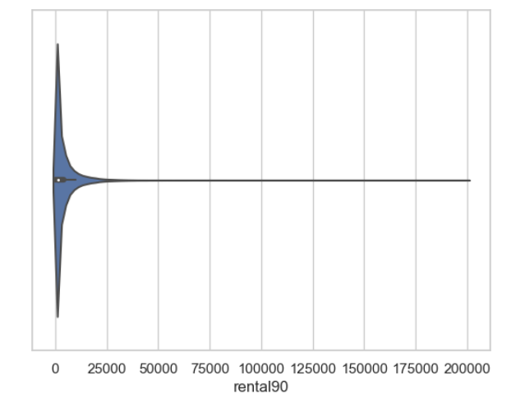
Violin plot of rental90:
As we can see, average main account balance over last 90 days for majority of the customers is 0.

Slide 18
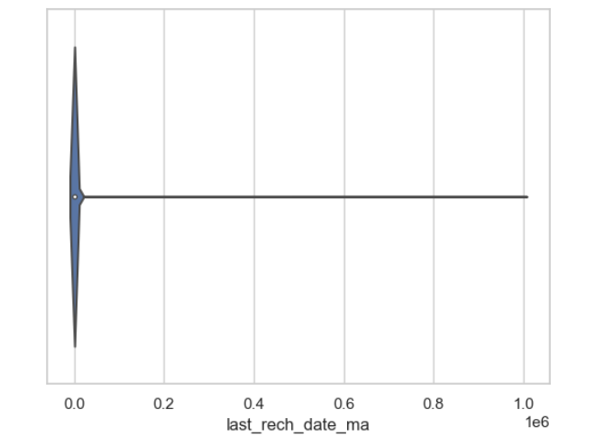
Violin plot of last_rech_date_ma:
As we can see, number of days till last recharge of main account for majority of the customers is 1.

Slide 19
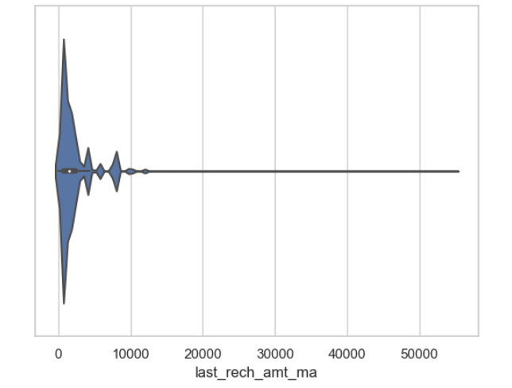
Violin plot of last_rech_amt_ma:
As we can see, amount of last recharge of main account for majority of the customers is 1539.

Slide 20
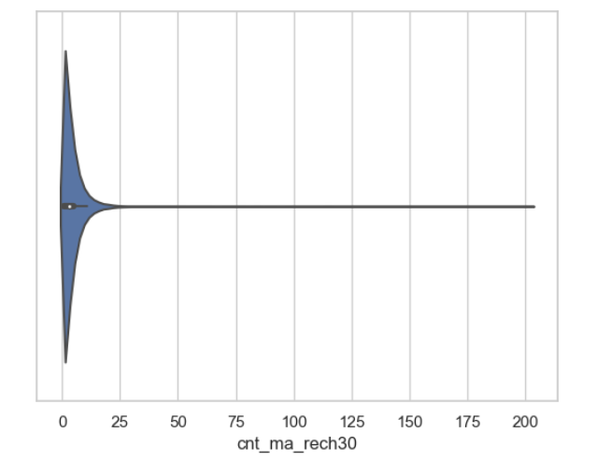
Violin plot of cnt_ma_rech30:
As we can see, number of times main account got recharged in last 30 days for majority of the customers is 1.

Slide 21
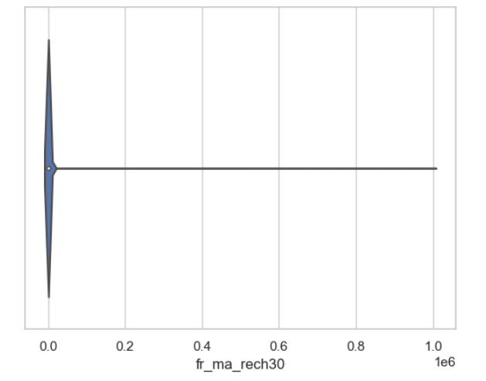
Violin plot of fr_ma_rech30:
As we can see, frequency of main account recharged in last 30 days for majority of the customers is 0.

Slide 22
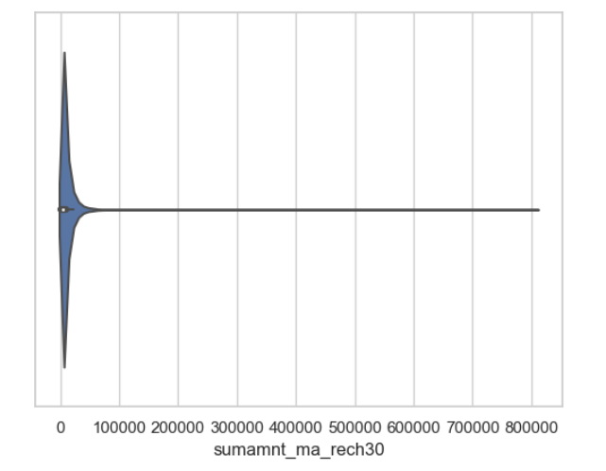
Violin plot of sumamnt_ma_rech30:
As we can see, total amount of recharge in main account over last 30 days for majority of the customers is 0.

Slide 23
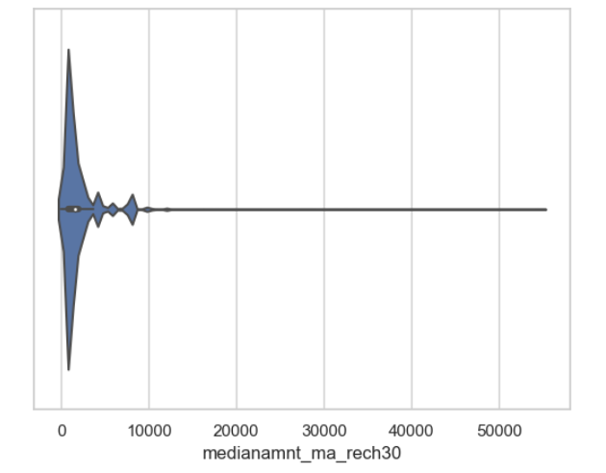
Violin plot of medianamnt_ma_rech30:
As we can see, median of amount of recharges done in main account over last 30 days at user level for majority of the customers is 1539.

Slide 24
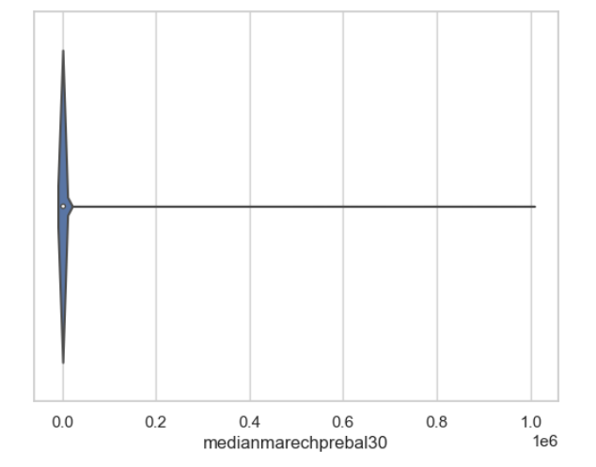
Violin plot of medianmarechprebal30:
As we can see, median of main account balance just before recharge in last 30 days at user level for majority of the customers is 0.

Slide 25
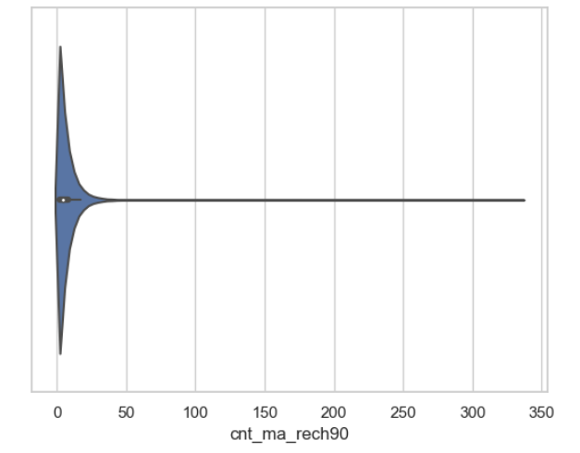
Violin plot of cnt_ma_rech90:
As we can see, number of times main account got recharged in last 90 days for majority of the customers is 1.

Slide 26
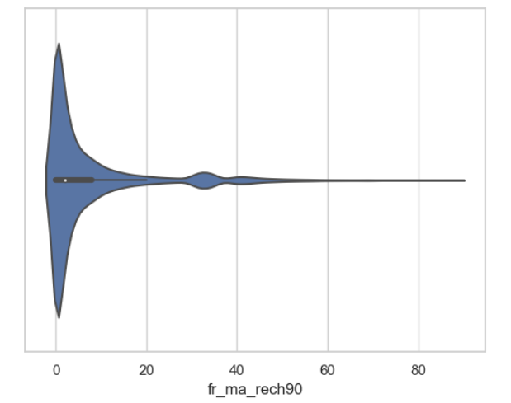
Violin plot of fr_ma_rech90:
As we can see, frequency of main account recharged in last 90 days for majority of the customers is 0.

Slide 27
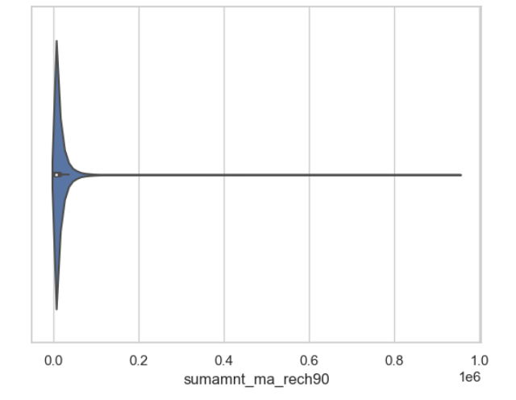
Violin plot of sumamnt_ma_rech90:
As we can see, total amount of recharge in main account over last 90 days for majority of the customers is 0.

Slide 28

Violin plot of medianamnt_ma_rech90:
As we can see, median of amount of recharges done in main account over last 90 days at user level for majority of the customers is 1539.

Slide 29
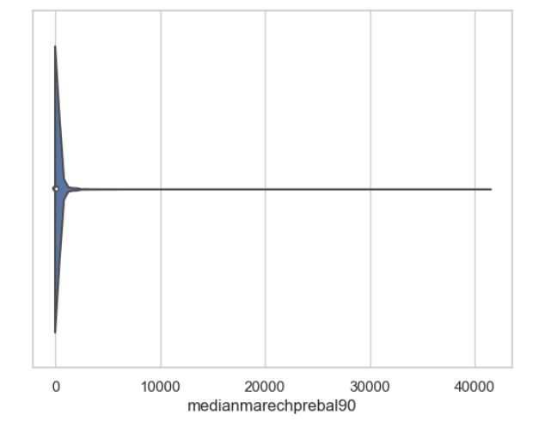
Violin plot of medianmarechprebal90:
As we can see, median of main account balance just before recharge in last 90 days at user level for majority of the customers is 0.

Slide 30
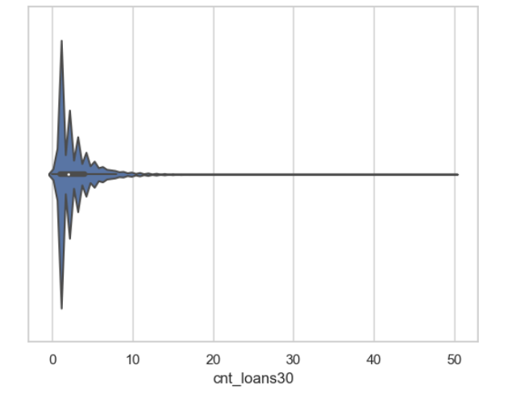
Violin plot of cnt_loans30:
As we can see, number of loans taken by user in last 30 days for majority of the customers is 1.

Slide 31
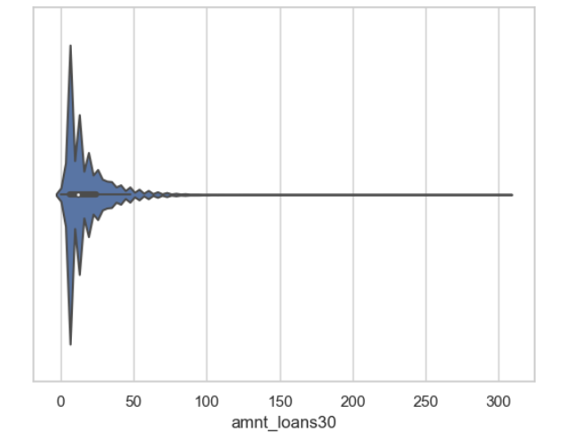
Violin plot of amnt_loans30:
As we can see, total amount of loans taken by user in last 30 days for majority of the customers is 6.

Slide 32
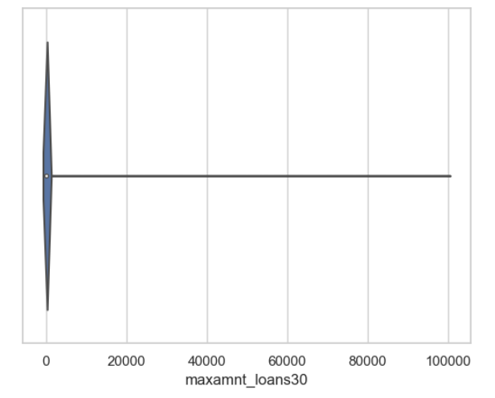
Violin plot of maxamnt_loans30:
As we can see, maximum amount of loan taken by the user in last 30 days for majority of the customers is 6.

Slide 33
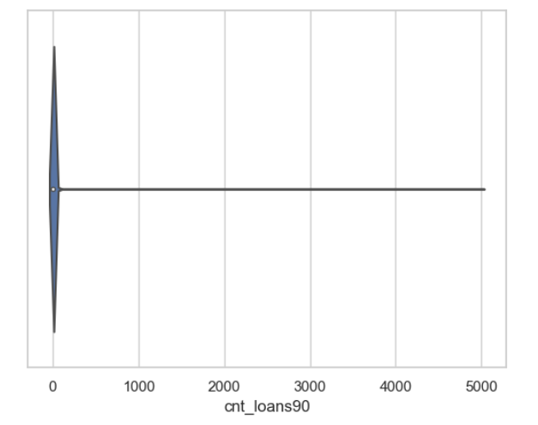
Violin plot of cnt_loans90:
As we can see, number of loans taken by user in last 90 days for majority of the customers is 1.

Slide 34
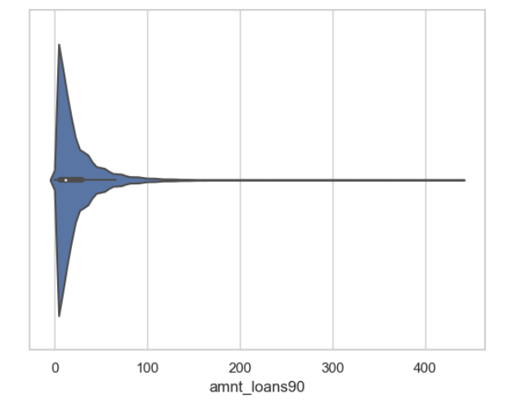
Violin plot of amnt_loans90:
As we can see, total amount of loans taken by user in last 90 days for majority of the customers is 6.

Slide 35
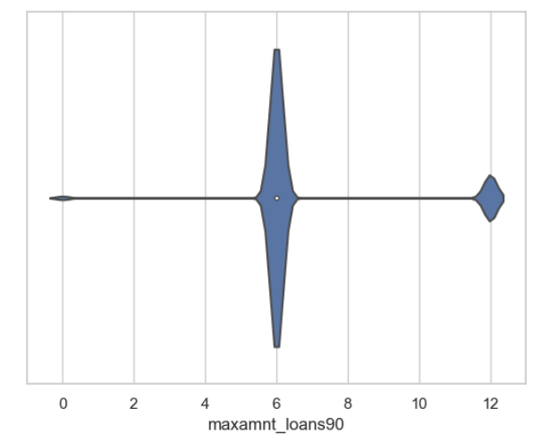
Violin plot of maxamnt_loans90 :
As we can see, maximum amount of loan taken by the user in last 90 days for majority of the customers is 6.

Slide 36
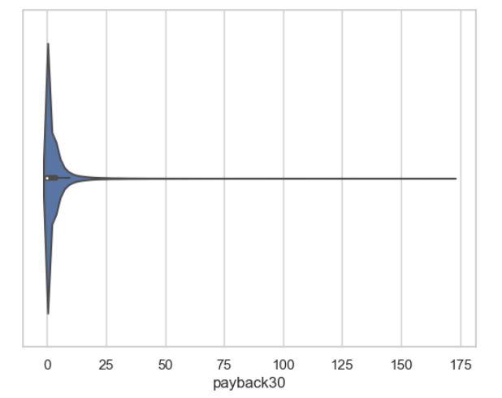
Violin plot of payback30:
As we can see, average payback time in days over last 30 days for majority of the customers is 0.

Slide 37

Violin plot of payback90:
As we can see, average payback time in days over last 90 days for majority of the customers is 0.

Slide 38
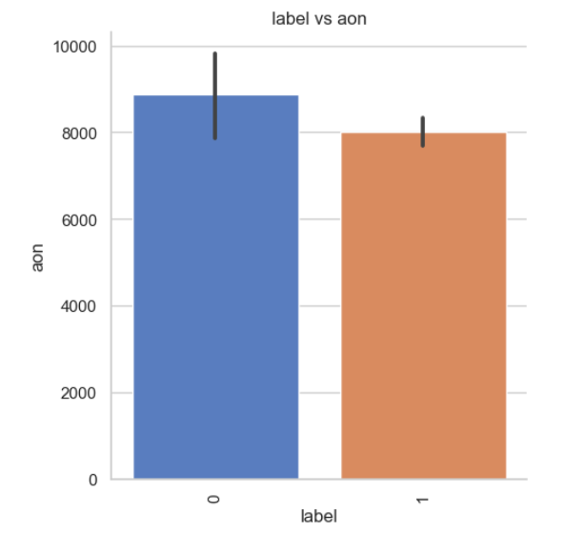
Bivariate analysis:
Factor plot of label vs aon:
As the age on cellular network increases, the chances of default increases.

Slide 39
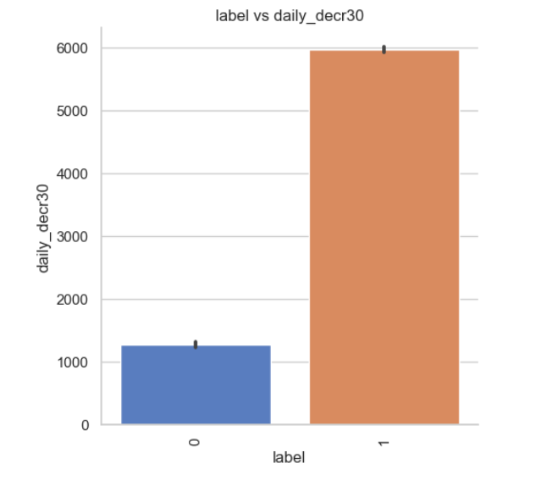
Factor plot of label vs daily_decr30:
As the daily amount spent from main account, averaged over last 30 days increases, the chances of default decreases.

Slide 40
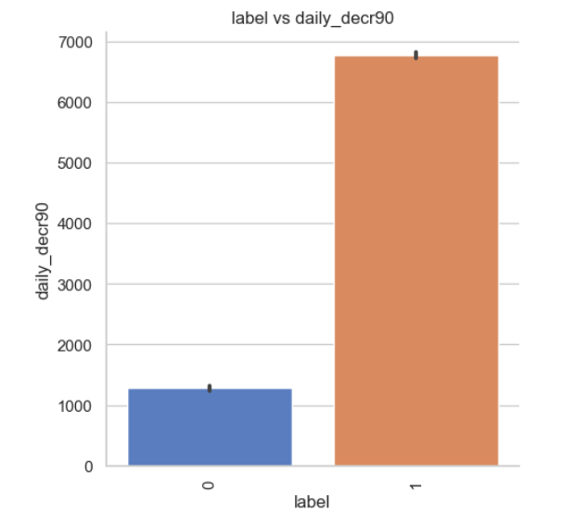
Factor plot of label vs daily_decr90:
As the daily amount spent from main account, averaged over last 90 days increases, the chances of default decreases.

Slide 41
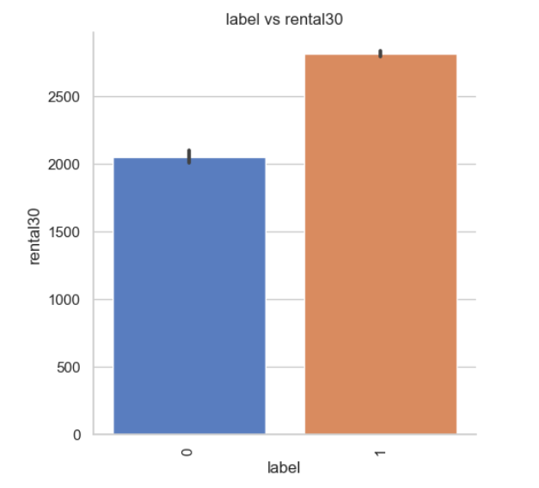
Factor plot of label vs rental30:
As the average main account balance over last 30 days increases, the chances of default decreases.

Slide 42
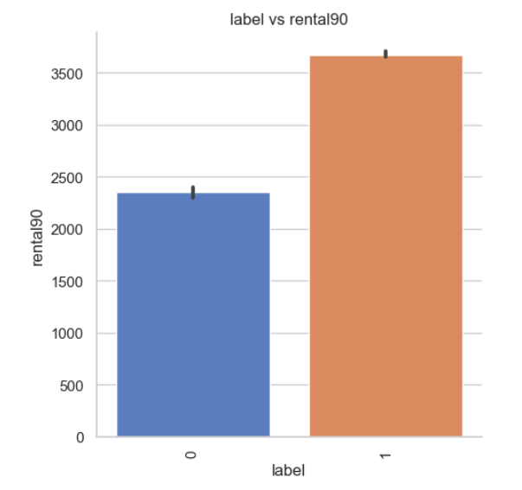
Factor plot of label vs rental90:
Average main account balance over last 90 days increases, the chances of default decreases.

Slide 43
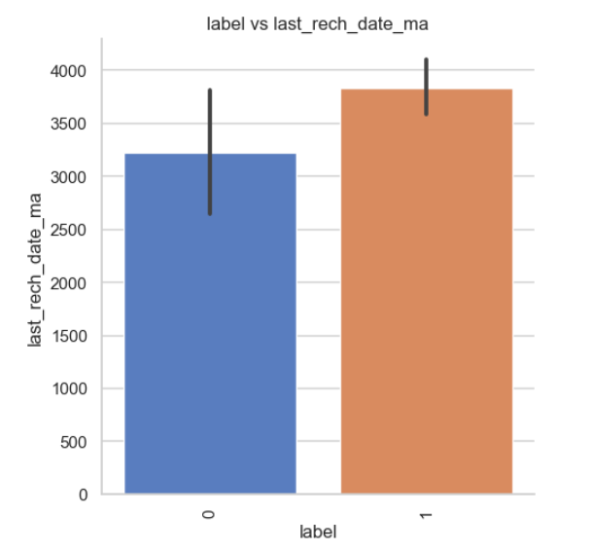
Factor plot of label vs last_rech_date_ma:
As the number of days till last recharge of main account increases, the chances of default decreases.

Slide 44
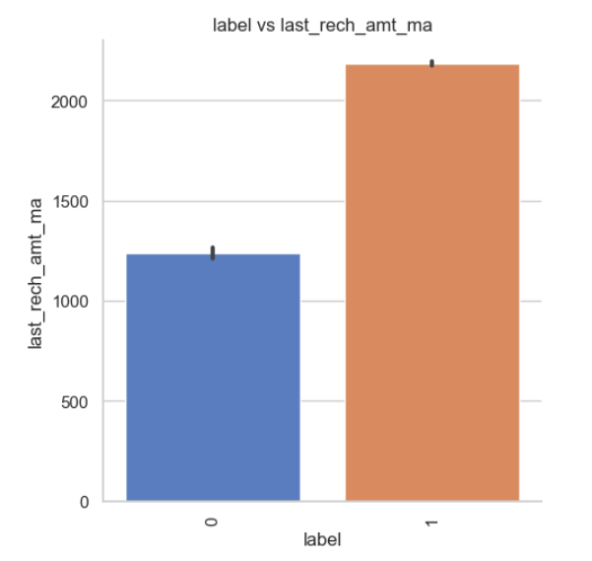
Factor plot of label vs last_rech_amt_ma:
As the amount of last recharge of main account increases, the chances of default decreases.

Slide 45
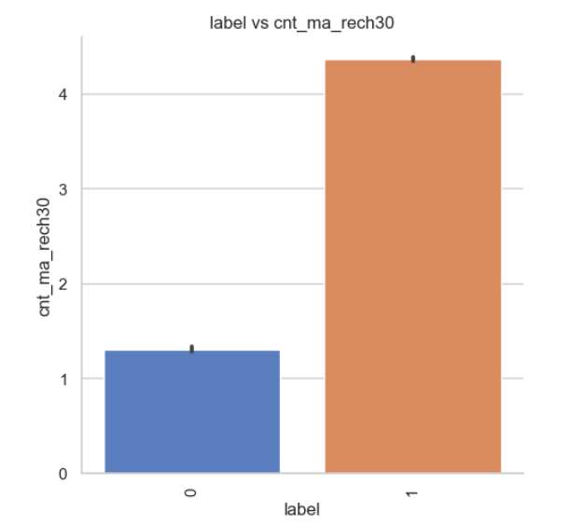
Factor plot of label vs cnt_ma_rech30:
As the number of times main account got recharged in last 30 days increases, the chances of default decreases.

Slide 46
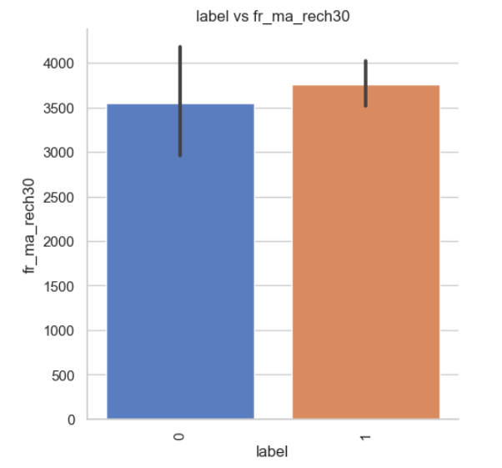
Factor plot of label vs fr_ma_rech30:
As the frequency of main account recharged in last 30 days increases, the chances of default decreases.

Slide 47
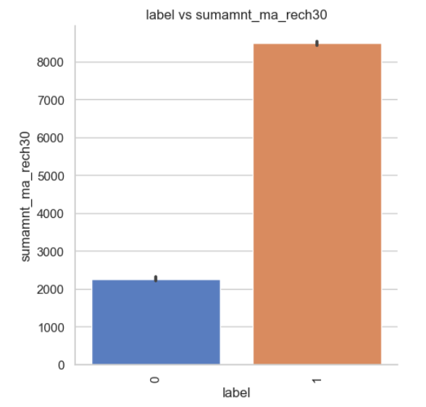
Factor plot of label vs sumamnt_ma_rech30:
As the total amount of recharge in main account over last 30 days increases, the chances of default decreases.

Slide 48
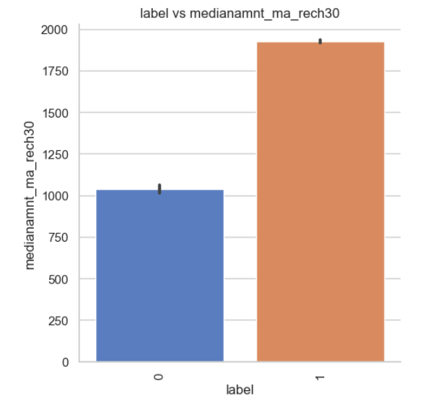
Factor plot of label vs medianamnt_ma_rech30:
As the median of amount of recharges done in main account over last 30 days at user level increases, the chances of default decreases.

Slide 49
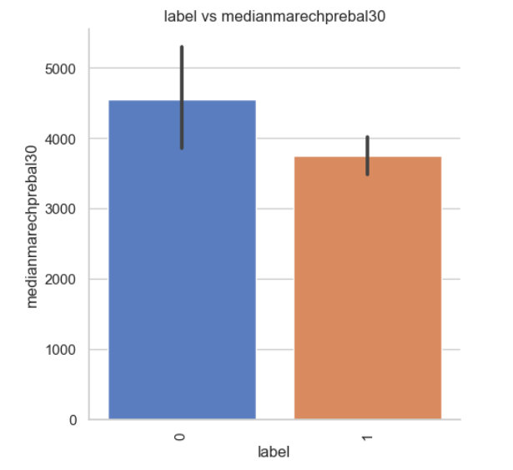
Factor plot of label vs medianmarechprebal30:
As the median of main account balance just before recharge in last 30 days at user level increases, the chances of default increases.

Slide 50
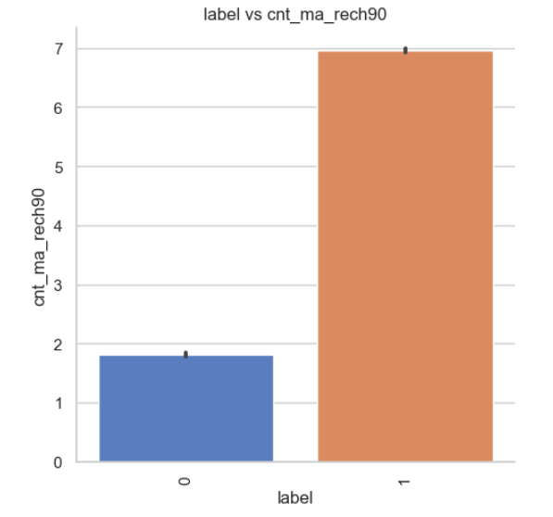
Factor plot of label vs cnt_ma_rech90:
As the number of times main account got recharged in last 90 days increases, the chances of default decreases.

Slide 51
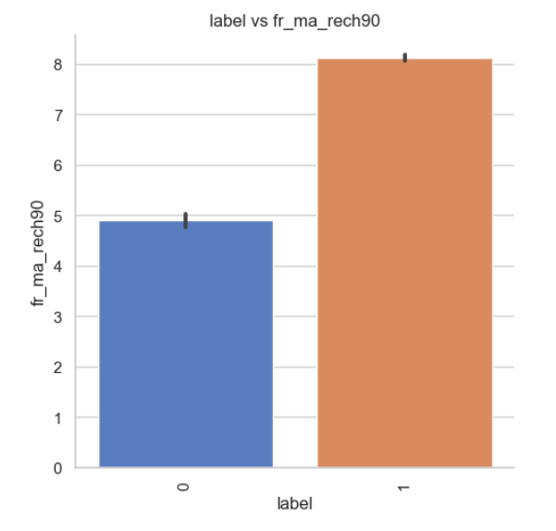
Factor plot of label vs fr_ma_rech90:
As the frequency of main account recharged in last 90 days increases, the chances of default decreases.

Slide 52
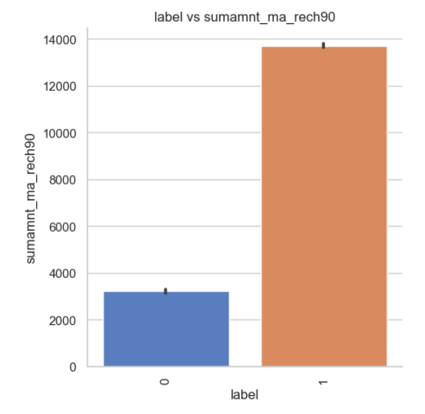
Factor plot of label vs sumamnt_ma_rech90:
As the total amount of recharge in main account over last 90 days increases, the chances of default decreases.

Slide 53
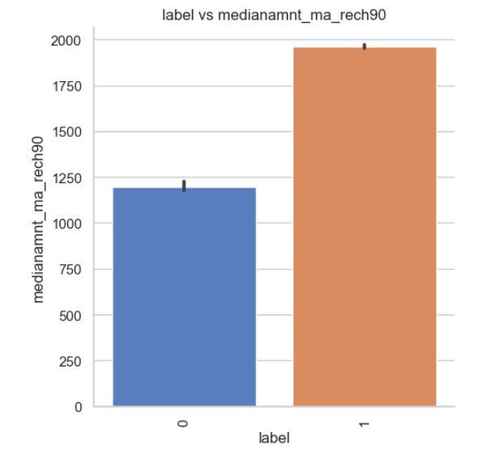
Factor plot of label vs medianamnt_ma_rech90:
As the median of amount of recharges done in main account over last 90 days at user level increases, the chances of default decreases.

Slide 54
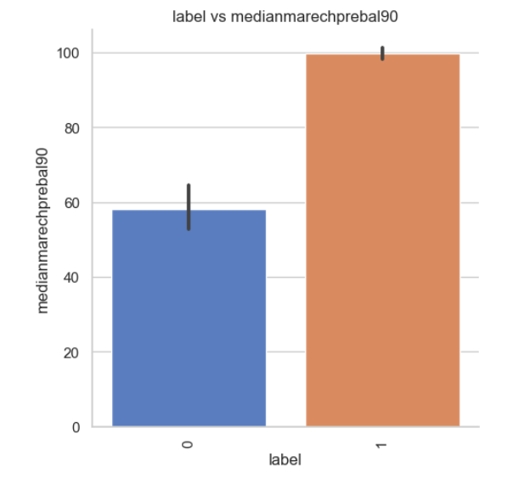
Factor plot of label vs medianmarechprebal90:
As the median of main account balance just before recharge in last 90 days at user level increases, the chances of default decreases.

Slide 55
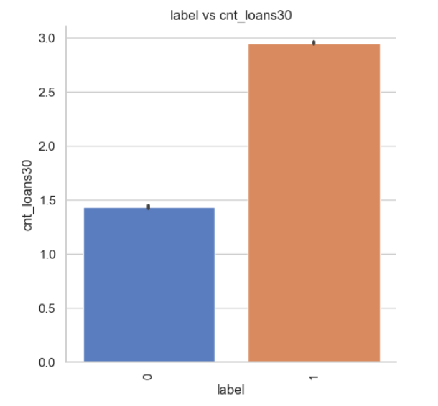
Factor plot of label vs cnt_loans30:
As the number of loans taken by user in last 30 days increases, the chances of default decreases.

Slide 56
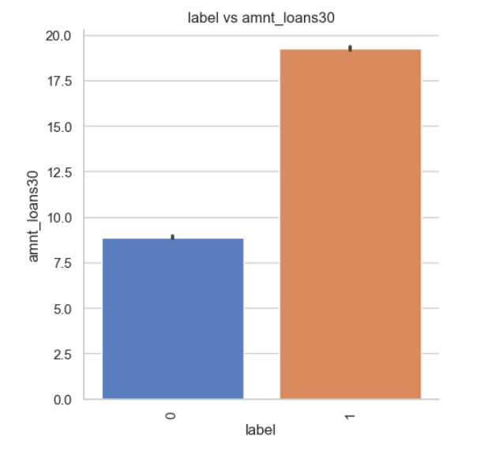
Factor plot of label vs amnt_loans30:
As the total amount of loans taken by user in last 30 days increases, the chances of default decreases.

Slide 57
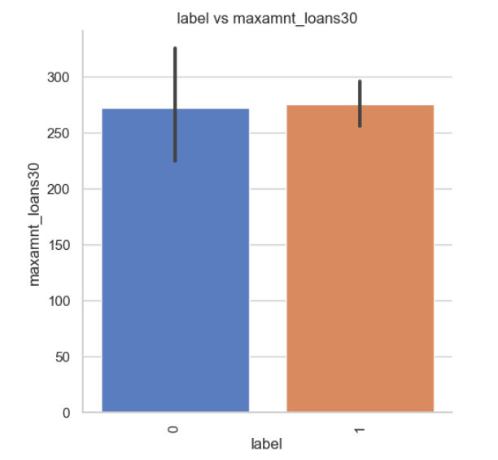
Factor plot of label vs maxamnt_loans30:
As the maximum amount of loan taken by the user in last 30 days increases, the chances of default decreases slightly.

Slide 58
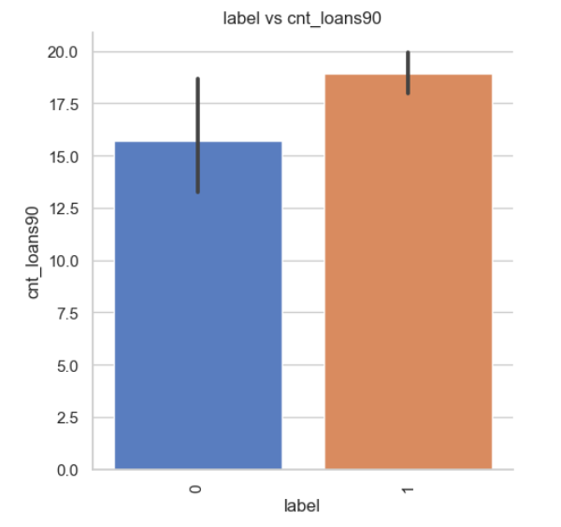
Factor plot of label vs cnt_loans90:
As the number of loans taken by user in last 90 days increases, the chances of default decreases.

Slide 59
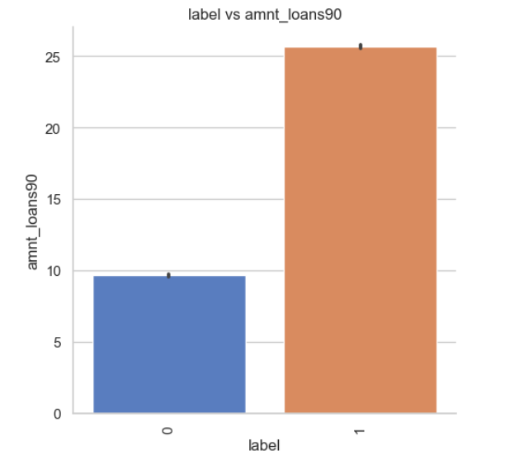
Factor plot of label vs amnt_loans90:
As the total amount of loans taken by user in last 90 days increases, the chances of default decreases.

Slide 60
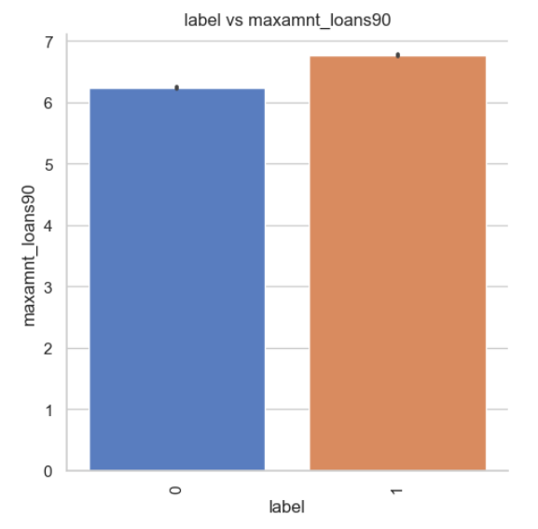
Factor plot of label vs maxamnt_loans90:
As the maximum amount of loan taken by the user in last 90 days increases, the chances of default decreases.

Slide 61
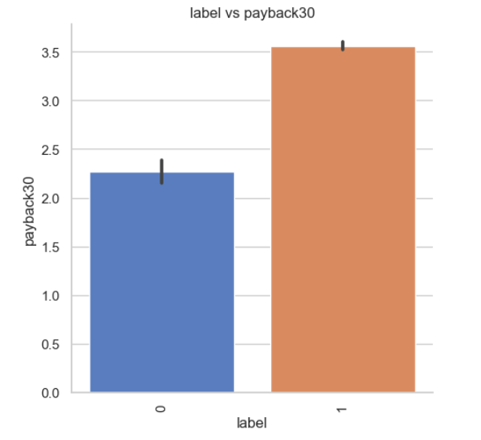
Factor plot of label vs payback30:
As the average payback time in days over last 30 days increases, the chances of default decreases.

Slide 62
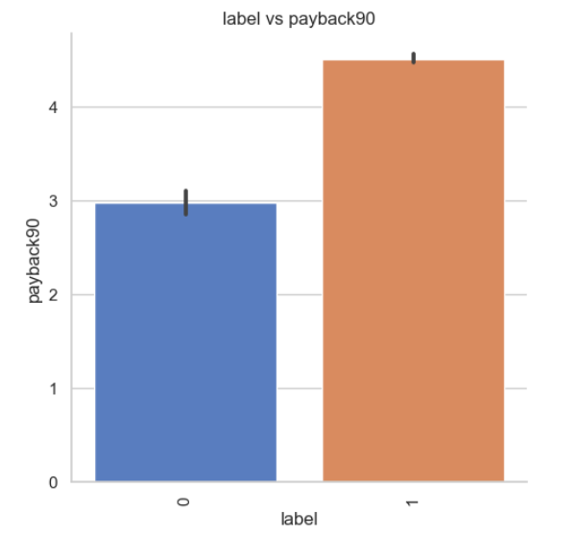
Factor plot of label vs payback90:
As the average payback time in days over last 90 days increases, the chances of default decreases.

Slide 63

Count plot of label vs Day:
As we can see, no significant observation is found from the above plot.

Slide 64

Count plot of label vs Month:
As we can see, the chances of default decreases, if the loan is taken in the 7th month. Also, there are defaulters in the 8th month.

Slide 65

Multivariate analysis:
Checking 'Month' and 'cnt_ma_rech90' with respect to 'label’:
As 'cnt_ma_rech90' increases in the 8th month, the number of non-defaulters also increases.

Slide 66

Scatter plot between 'cnt_ma_rech_30' and 'cnt_ma_rech90' with respect to 'label':
As 'cnt_ma_rech30' and 'cnt_ma_rech90' are increasing the number of non-defaulters are also increasing.

Slide 67

Scatter plot between 'cnt_loans30' and 'cnt_amnt30' with respect to label:
As 'cnt_loans30' and 'cnt_amnt30' are increasing the number of non-defaulters are also increasing.

Slide 68

Scatter plot between 'sumamnt_ma_rech90' and 'amnt_loans90' with respect to 'label':
As 'sumamnt_rech90' and 'amnt_loans30' are increasing, the number of non-defaulters are also increasing.

Slide 69

Model building:

Slide 70

1) Decision Tree Classifier:
Decision Tree Classifier is giving us an accuracy of 91.64%.

Slide 71

2) Random Forest Classifier:
Random Forest Classifier is giving us an accuracy of 95.41%.

Slide 72


3) Extra Trees Classifier:
Extra Trees Classifier is giving us an accuracy of 96.11%.

Slide 73


4) Gradient Boosting Classifier:
Gradient Boosting Classifier is giving us an accuracy of 90.39%.

Slide 74

5) Extreme Gradient Boosting Classifier (XGB Classifier):
Extreme Gradient Boosting Classifier is giving us an accuracy of 95.24%.

Slide 75

6) Bagging Classifier:
Bagging Classifier is giving us an accuracy of 94.25%.

Slide 76

Plotting ROC and Comparing AUC for all the models used:

Slide 77

Hyperparameter Tuning:

Slide 78



Slide 79

Plotting ROC and Comparing AUC for the Final model:

Slide 80


Saving the model:
Loading and Predicting the saved model:

Slide 81
Conclusion:
We have used multiple machine learning models to predict the micro credit defaulters’ rate. We have gone through the data analysis by performing feature engineering, finding the relation between features and label through visualizations. And got the important feature and we used these features to predict the defaulters’ rate by building ML models. After training the model we checked CV score to overcome with the overfitting issue. Performed hyper parameter tuning, on the best model and the best model accuracy increased by 5% and the accuracy score was 95%. We have also got good prediction results.
From the whole study we found that the MFIs have provided loan to the user who have no recharge or balance in their account which needs to be stopped. Also, the frequency of main account recharged in last 30 days & 90 days we have seen the users with low frequency are causing huge losses, company should implement some kind of strategies to reduce like sending SMS alerts for notification. We found the defaulting rate is higher in old customers list. We found outliers and removed them and couldn’t remove all the outliers since the data is expensive so, proceeded the data with remaining outliers. Further, removed skewness. Looking at the heat map, I could see there were few features which were correlated with each other, yet I haven’t removed them based on their correlation thinking multicollinearity will not affect prediction. Other insight from this study is the impact of SMOTE on the model performance as well as how the number of variables included in the models.

Slide 82


